Slide 1
Course Review and Summary
Xiangyi Chen
xiangyichen@swjtu.edu.cn

Slide 2
Outline
5. Memory management
  5.1 Logical organization
  5.2 Physical organization
  5.3 Memory Management Techniques
    Dynamic partition
    Fixed partition
    Page
    Segment
  5.4 Address translation
6. Virtual Memory
  6.1Replacement policy
  6.2Resident set management

Slide 3
Outline (cont.)
7. I/O Management
  Evolution of the I/O function
  I/O buffer
  Disk scheduling
  Disk cache
8. File management
  File organization and access
  File allocation methods
  Free space management

Slide 4
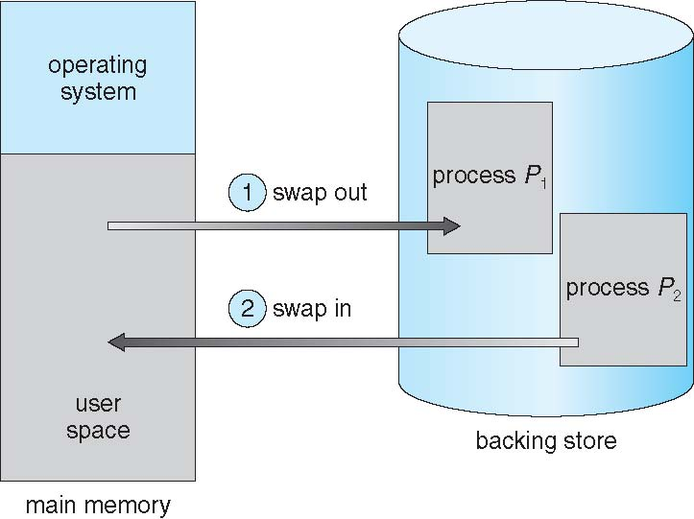
Relocation（重定位）
Programmers typically do not know in advance which other programs will be resident in main memory at the time of execution of their program
Active processes need to be able to be swapped in and out of main memory in order to maximize processor utilization
It is difficult to place in the same memory region once the process is swapped back.
Solution: relocate the process to a different area of memory

Slide 5
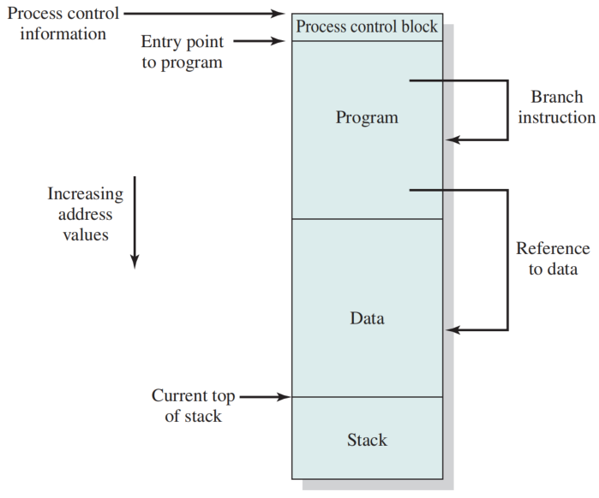
Addressing Requirements
Addressing Requirements for a Process

Slide 6
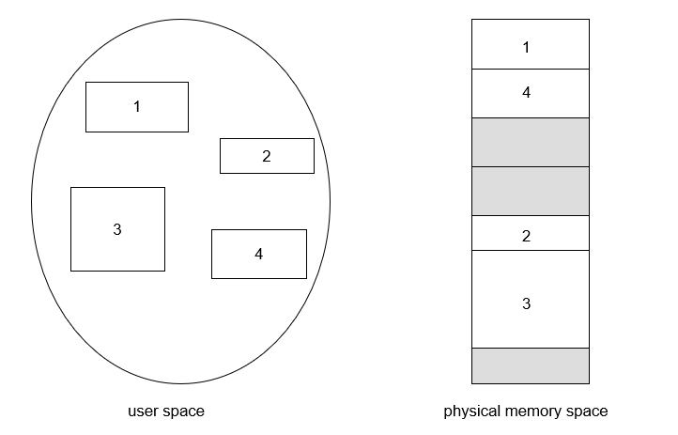
5. Logical Organization
Memory is organized as linear
Programs are written in modules
  modules can be written and compiled independently
  different degrees of protection given to modules (read-only, execute-only)
  sharing on a module level corresponds to the user’s way of viewing the problem

Slide 7
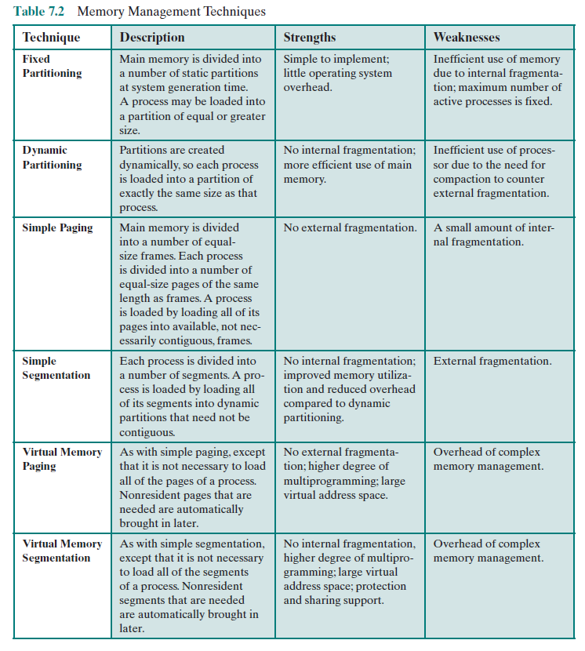
Memory Management Techniques

Slide 8
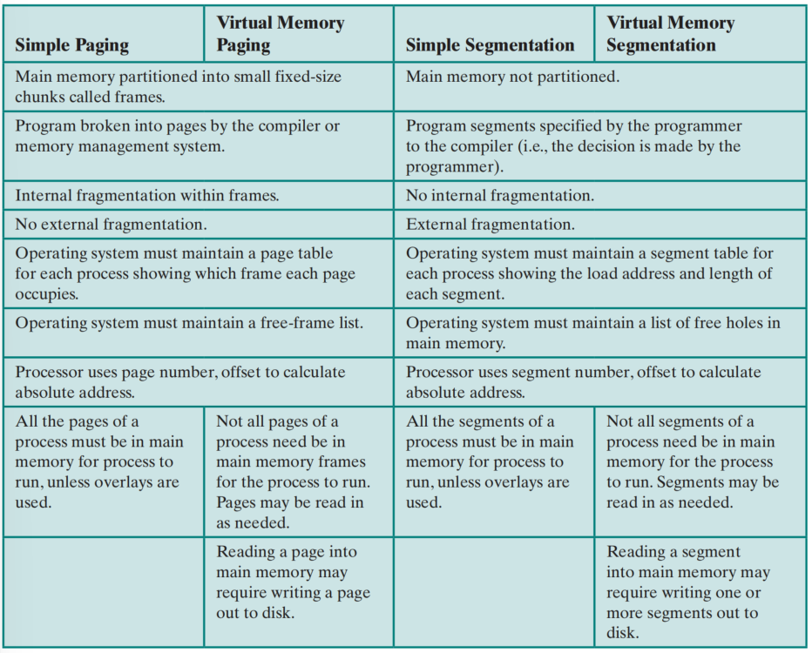
Characteristics of Paging and Segmentation

Slide 9
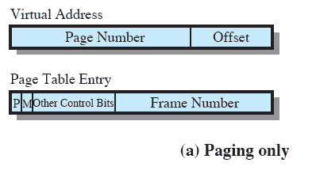
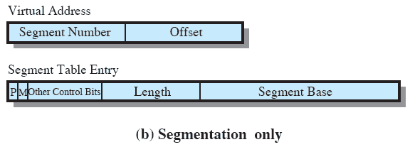
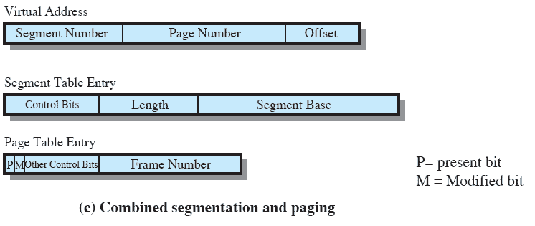
Memory Management Formats

Slide 10
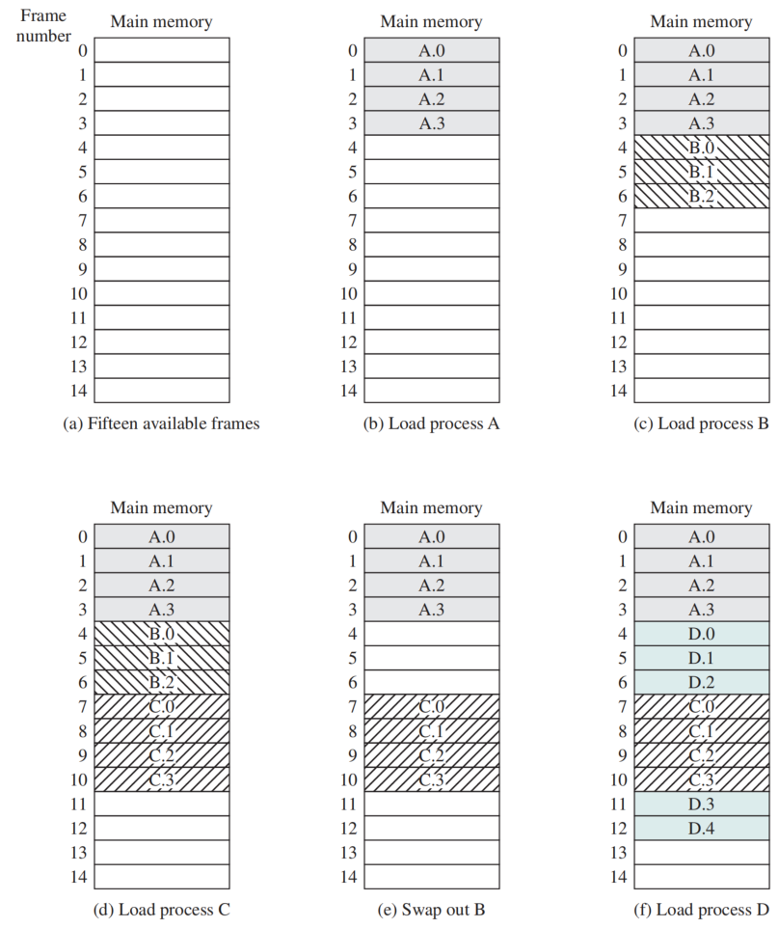
Paging
Partition memory into equal fixed-size chunks that are relatively small
  Frames
    available chunks of memory
Process is also divided into small fixed-size chunks of the same size
  Pages
    chunks of a process
Assignment of Process to Free Frames

Slide 11
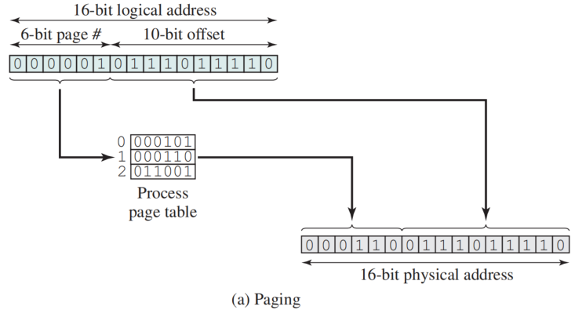
Logical-to-Physical Address Translation - Paging
Examples of Logical-to-Physical Address Translation

Slide 12
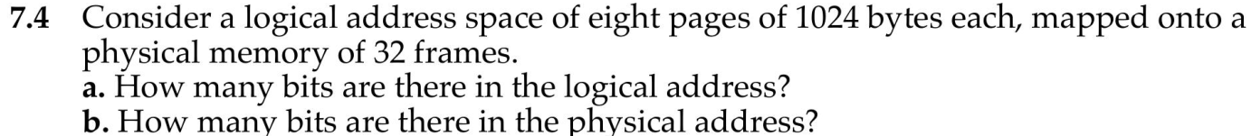
Quiz

Slide 13
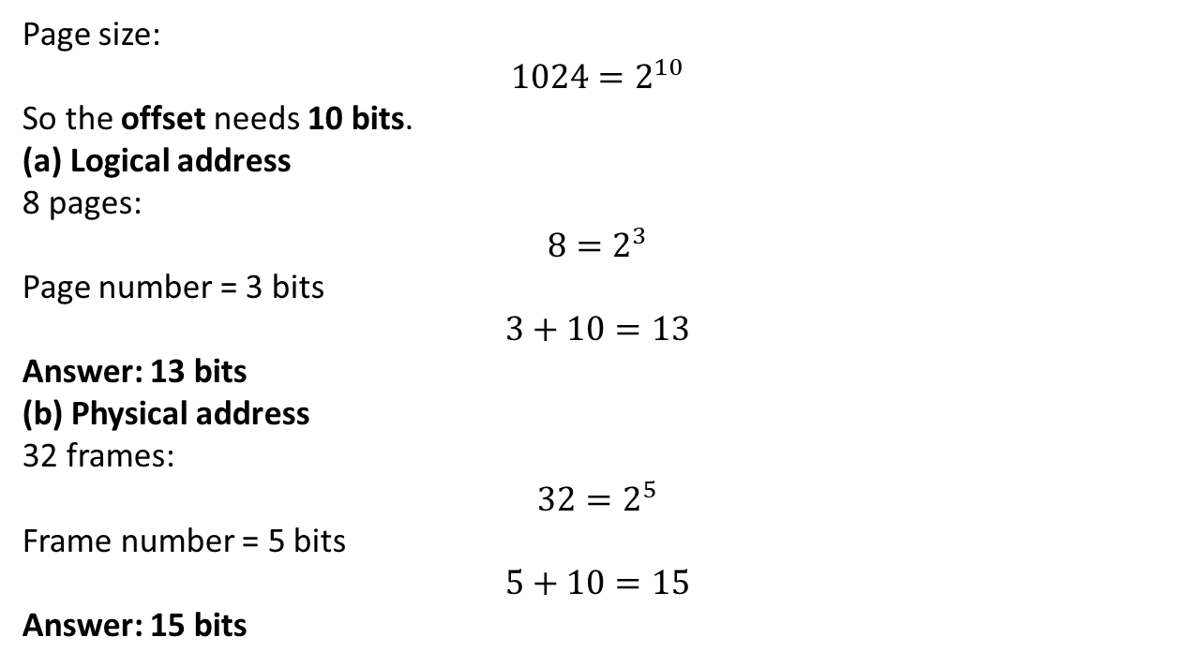
Quiz
Logical Address = Page Number + Offset
Page size:
$$1024=2^{10}$$
So the offset needs 10 bits.
(a) Logical address
8 pages:
$$8=2^{3}$$
Page number = 3 bits
$$3+10=13$$
Answer: 13 bits
(b) Physical address
32 frames:
$$32=2^{5}$$
Frame number = 5 bits
$$5+10=15$$
Answer: 15 bits

Slide 14
7.4 Segmentation
A program can be divided into different length of segments
  may vary in length
  there is a maximum length
Addressing consists of two parts:
  segment number
  an offset
Similar to dynamic partitioning, but the difference is：
  with segmentation, a program may occupy more than one partition, and these partitions need not be contiguous.
  Eliminates internal fragmentation, suffer from less external fragmentation

Slide 15
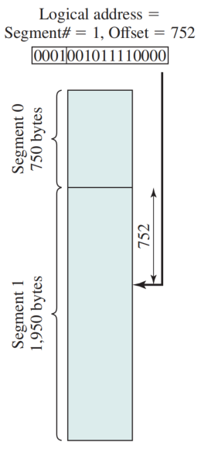
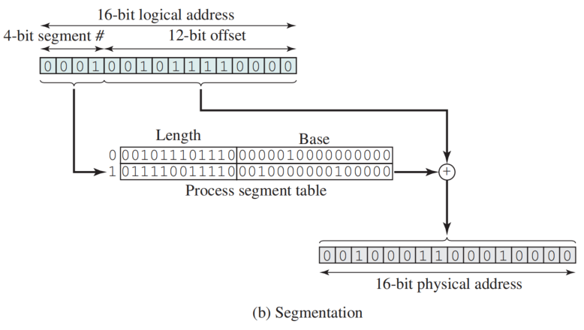
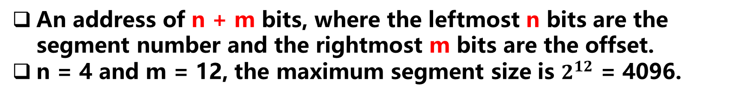
Logical-to-Physical Address Translation -Segmentation
An address of n + m bits, where the leftmost n bits are the segment number and the rightmost m bits are the offset.
n = 4 and m = 12, the maximum segment size is $2^{12}$ = 4096.
Examples of Logical-to-Physical Address Translation

Slide 16
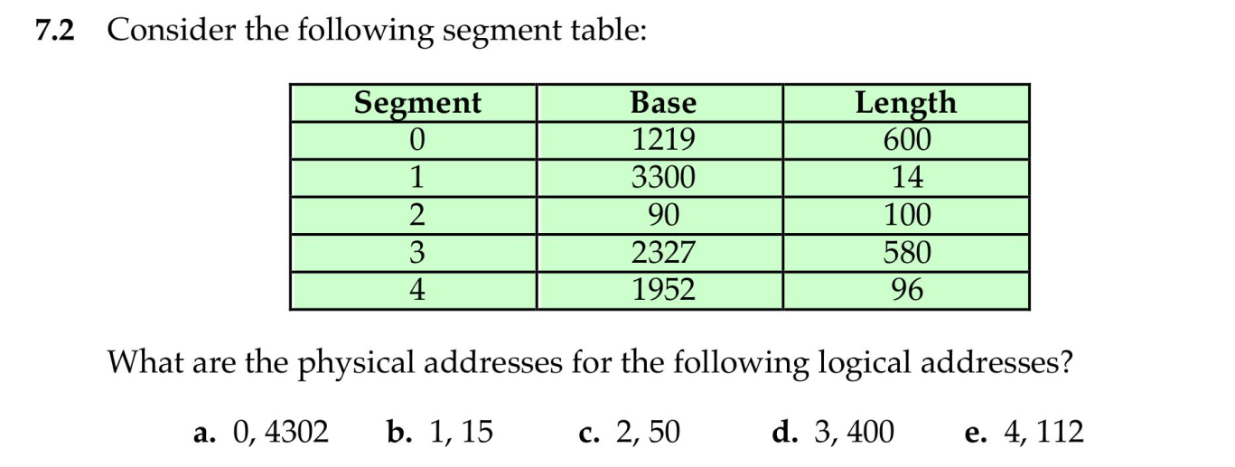
Quiz

Slide 17
Quiz
f. (1, 14)
Offset<Length ?
the offset is outside the segment bounds.
Illegal Reference (Out of Bounds)

Slide 18
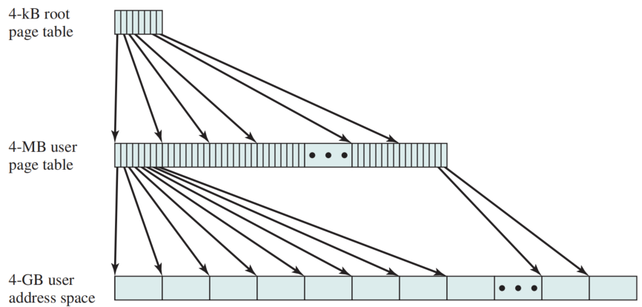
Two-Level Hierarchical Page Table（二级页表）

Slide 19
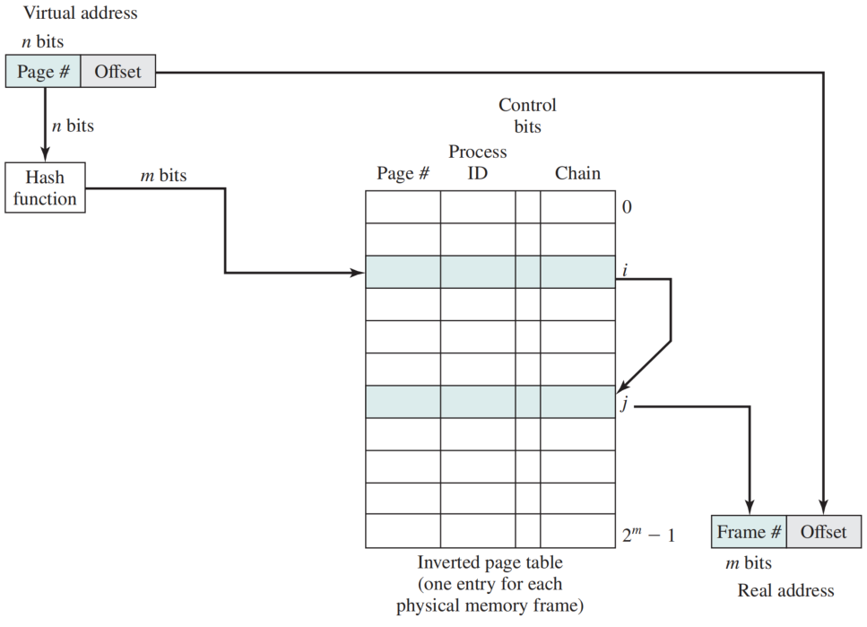
Inverted Page Table
Each entry in the page table includes:
  Page number
  Process identifier
  Control bits
    Flags: whether allocated
    Protection: access control
  Chain pointer
    the index value of the next entry in the chain

Slide 20
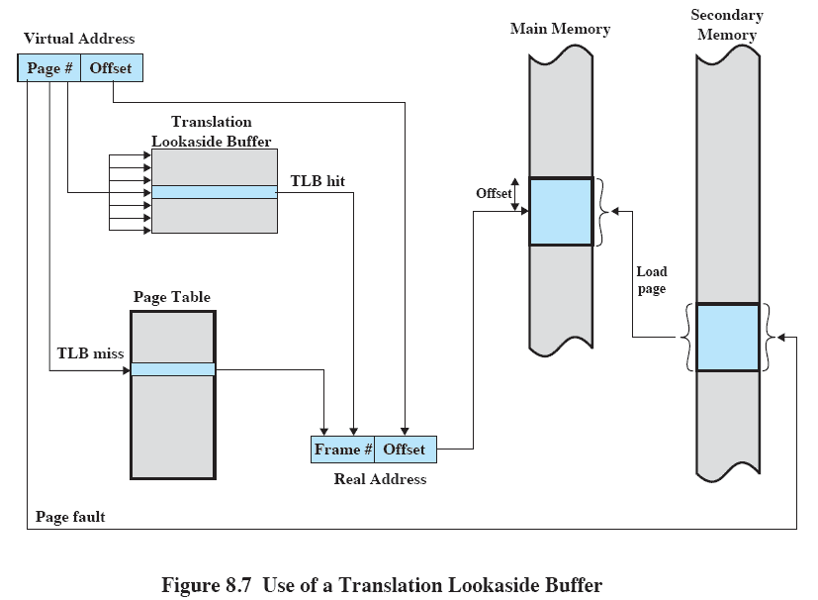
Use of a TLB

Slide 21
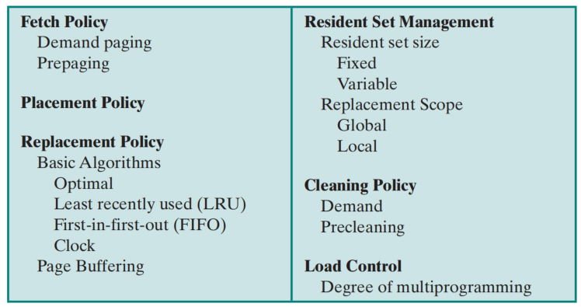
6. Operating System Policies for Virtual Memory
When
Where
which

Slide 22
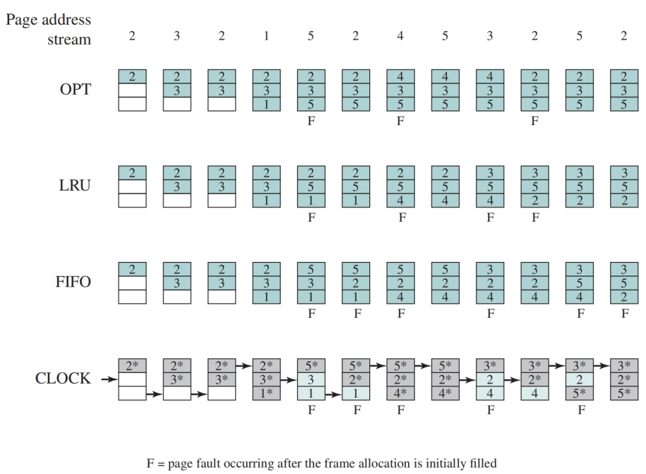
Combined Examples
Behavior of Four Page Replacement Algorithms

Slide 23
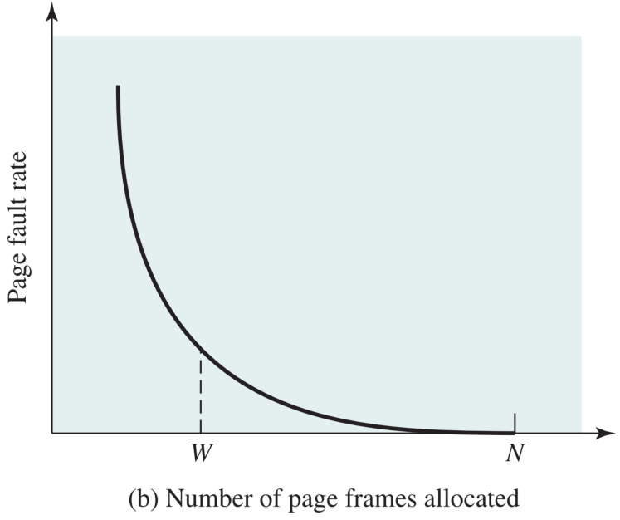
Resident Set Management
Definition: the portion of a process that is actually in main memory at any time is defined to be the resident set of the process
How many page frames are to be allocated to each active process
The set of pages for replacement should be limited to the process or all the page frames in main memory

Slide 24
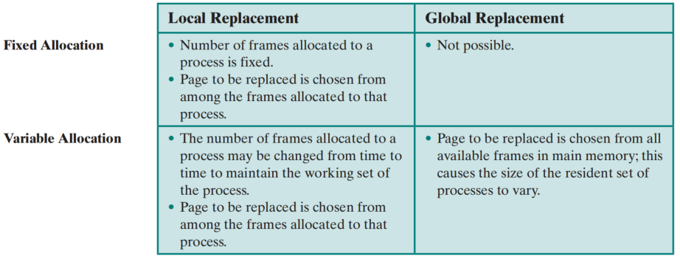
Resident Set Management Summary

Slide 25
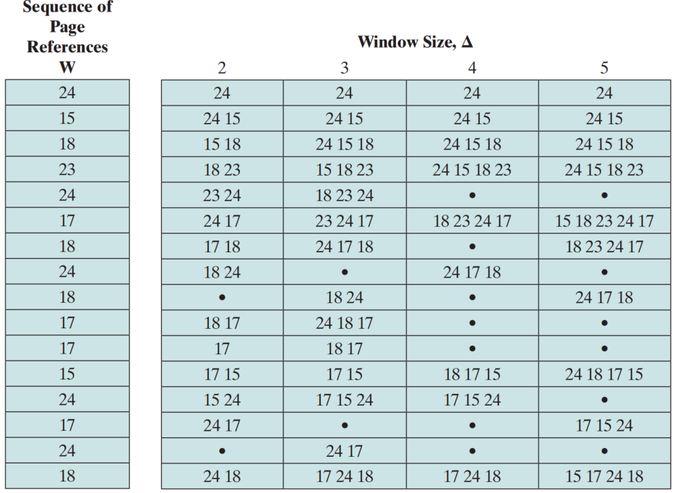
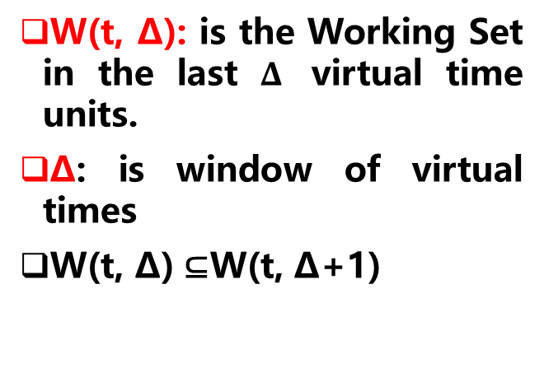
Working Set Strategy
W(t, ∆): is the Working Set in the last $Δ$ virtual time units.
∆: is window of virtual times
W(t, ∆) ⊆W(t, ∆+1)
Working Set of Process as Defined by Window Size

Slide 26
Guidance for Resident Size
Principles of working set guided strategies for resident set size
  Monitor the working set of each process.
  Periodically remove from the resident set of a process those pages that are not in its working set.
  A process may execute only if its working set is in main memory

Slide 27
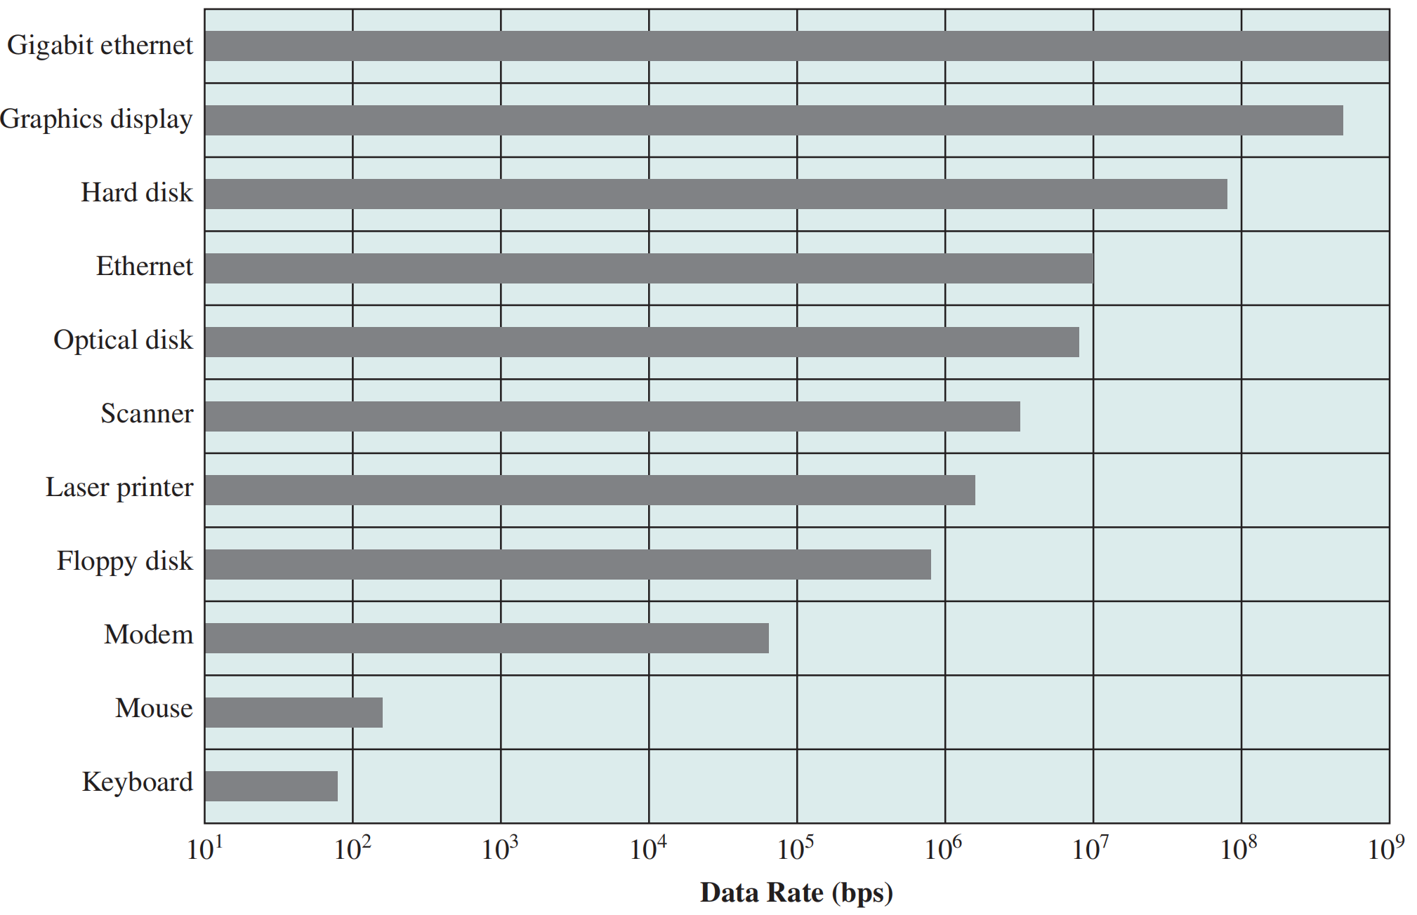
7 Differences in I/O Devices
Data rate
Application
Complexity of control
Unit of transfer
Data representation
Error conditions

Slide 28
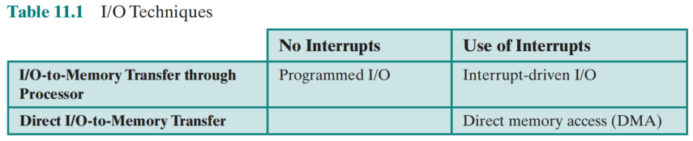
2. Organization of the I/O Function
Programmed I/O
  processor issues an I/O command，on behalf of a process，to an I/O module;
  that process then busy waits for the operation to be completed before proceeding
Interrupt-driven I/O
  processor issues an I/O command on behalf of a process
  non-blocking VS blocking
Direct Memory Access (DMA)
  a DMA module controls the exchange of data between main memory and an I/O module

Slide 29
Evolution of the I/O Function
Processor directly controls a peripheral device
A controller or I/O module is added
Same configuration as step 2, but now interrupts are employed
The I/O module is given direct control of memory via DMA（直接存储访问器）
The I/O module is enhanced to become a separate processor, with a specialized instruction set tailored for I/O I/O channel （I/O通道）
The I/O module has a local memory of its own and is, in fact, a computer in its own right I/O processor

Slide 30
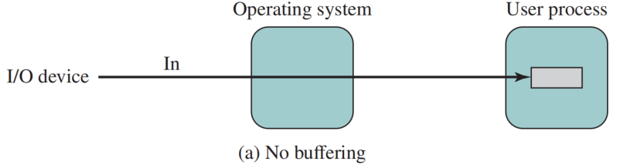
Buffering
No Buffer
  Without a buffer, the OS directly accesses the device when it needs
  Disadvantage: block/swap

Slide 31
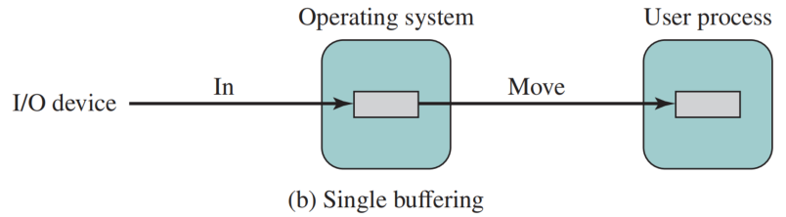

Single Buffer
Operating system assigns a buffer in main memory for an I/O request.
Producer/customer
C
M
T

Slide 32
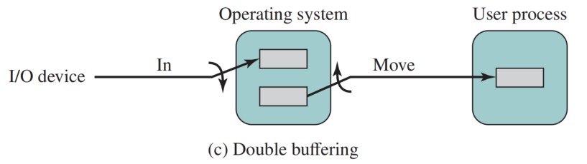
Double Buffer
Use two system buffers instead of one
A process can transfer data to or from one buffer while the operating system empties or fills the other buffer
Also known as buffer swapping （缓冲交换）

Slide 33
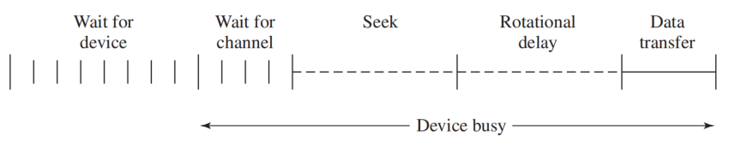
5 Disk Scheduling ——Disk Performance Parameters
The actual details of disk I/O operation depend on the:
  computer system
  operating system
  nature of the I/O channel and disk controller hardware
Timing of a Disk I/O Transfer

Slide 34
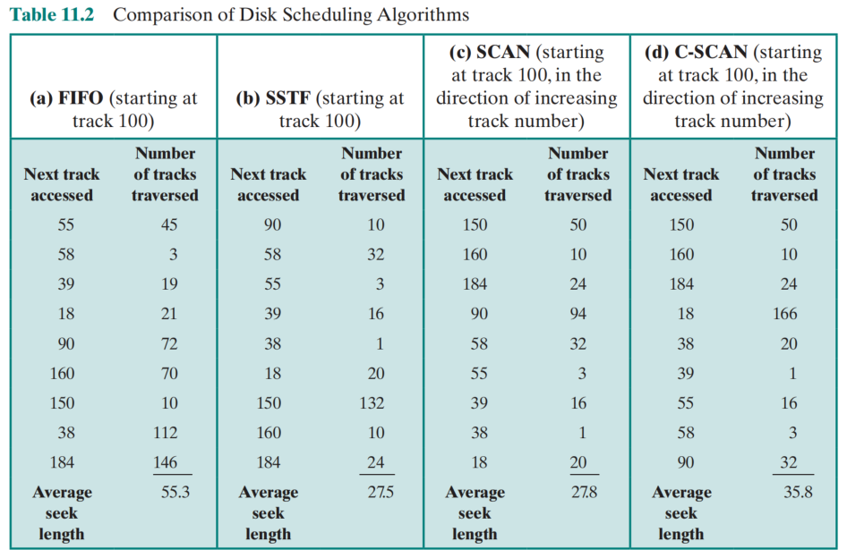
Disk Scheduling Policies
To improve matters, we need to reduce the average time spent on seeks via disk scheduling policies.
Case: 55, 58, 39, 18, 90, 160, 150, 38, 184
First-In-First-Out
Priority
Last-In-First-Out
Shortest-Service-Time-First
SCAN
C-SCAN
N-STEP-SCAN
FSCAN

Slide 35
Disk Cache
Cache memory is used to apply to a memory that is smaller and faster than main memory and that is interposed between main memory and the processor
Disk cache is a buffer in main memory for disk sectors
  Contains a copy of some of the sectors on the disk
when an I/O request is made for a particular sector, a check is made to determine if the sector is in the disk cache
  if YES
    the request is satisfied via the cache
  if NO
    the requested sector is read into the disk cache from the disk

Slide 36
Replacement strategy
A second design issue has to do with the replacement strategy
least recently used (LRU)（ most commonly used ）
least frequently used (LFU)

Slide 37
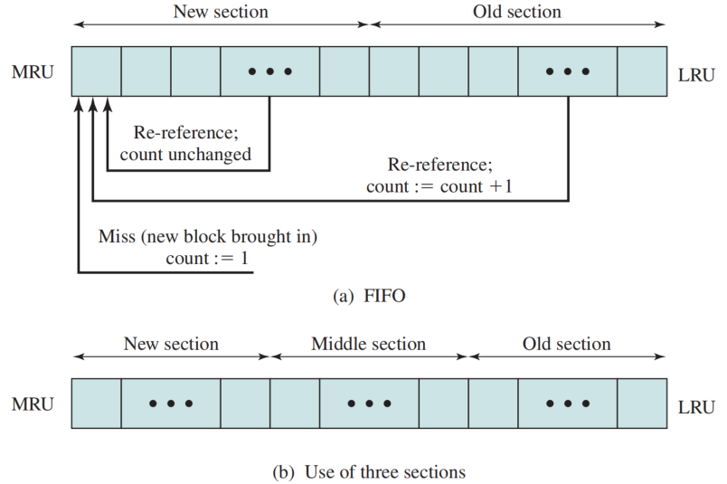
Frequency-Based Replacement
Frequency-Based Replacement

Slide 38
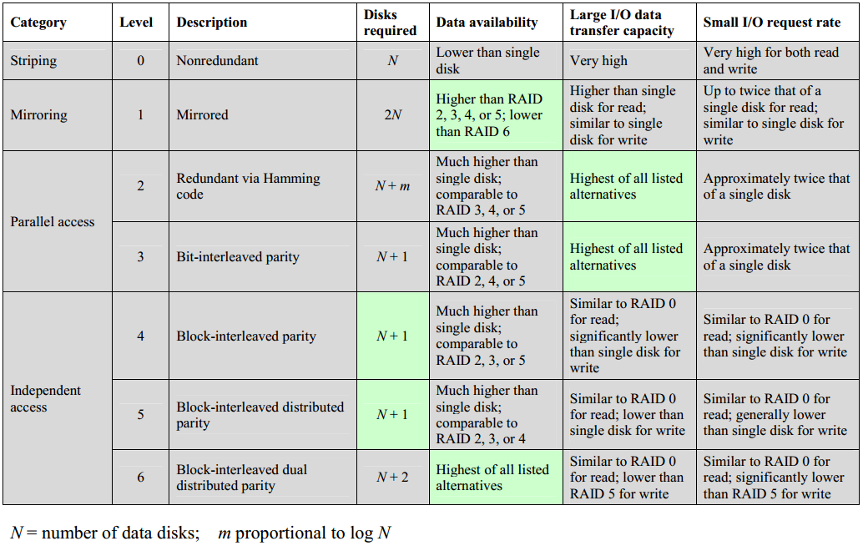
RAID Levels

Slide 39
Case Discussion
Consider a disk with an advertised average seek time of 4 ms, rotation speed of 7,500 rpm, and 512-byte sectors with 500 sectors per track. Suppose we wish to read a file consisting of 2,500 sectors for a total of 1.28 Mbytes.
We would like to estimate the total time for the transfer.

Slide 40
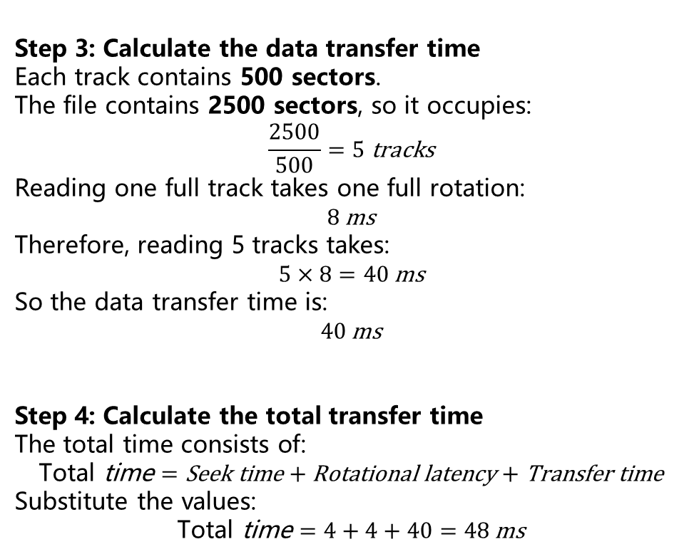
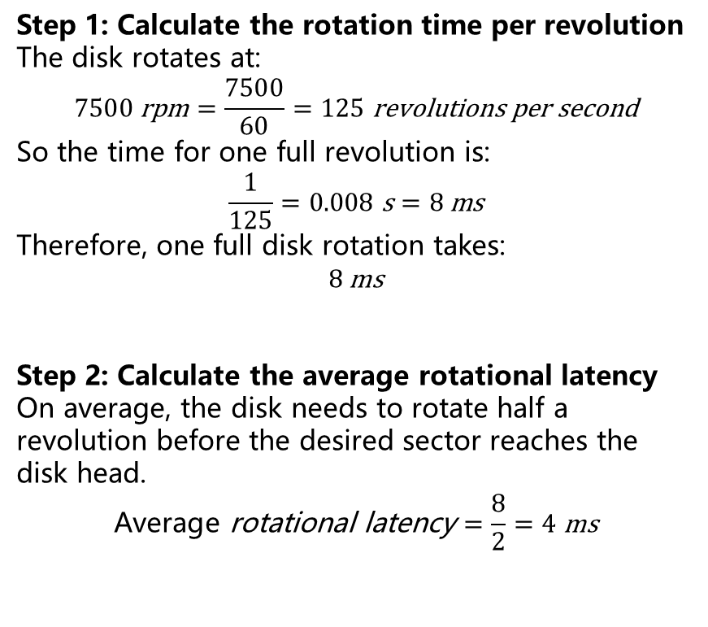
Given:
Average seek time = 4 ms
Rotation speed = 7500 rpm
Sector size = 512 bytes
Sectors per track = 500
File size = 2500 sectors
Step 3: Calculate the data transfer time
Each track contains 500 sectors.
The file contains 2500 sectors, so it occupies:
$$\frac{2500}{500}=5 \text{tracks}$$
Reading one full track takes one full rotation:
$$8 \text{ms}$$
Therefore, reading 5 tracks takes:
$$5×8=40 \text{ms}$$
So the data transfer time is:
$$40 \text{ms}$$
Step 4: Calculate the total transfer time
The total time consists of:
$$\text{Total} \text{time}=\text{Seek} \text{time}+\text{Rotational} \text{latency}+\text{Transfer} \text{time}$$
Substitute the values:
$$\text{Total} \text{time}=4+4+40=48 \text{ms}$$
Step 1: Calculate the rotation time per revolution
The disk rotates at:
$$7500 \text{rpm}=\frac{7500}{60}=125 \text{revolutions} \text{per} \text{second}$$
So the time for one full revolution is:
$$\frac{1}{125}=0.008 \text{s}=8 \text{ms}$$
Therefore, one full disk rotation takes:
$$8 \text{ms}$$
Step 2: Calculate the average rotational latency
On average, the disk needs to rotate half a revolution before the desired sector reaches the disk head.
$$\text{Average} \text{rotational} \text{latency}=\frac{8}{2}=4 \text{ms}$$

Slide 41
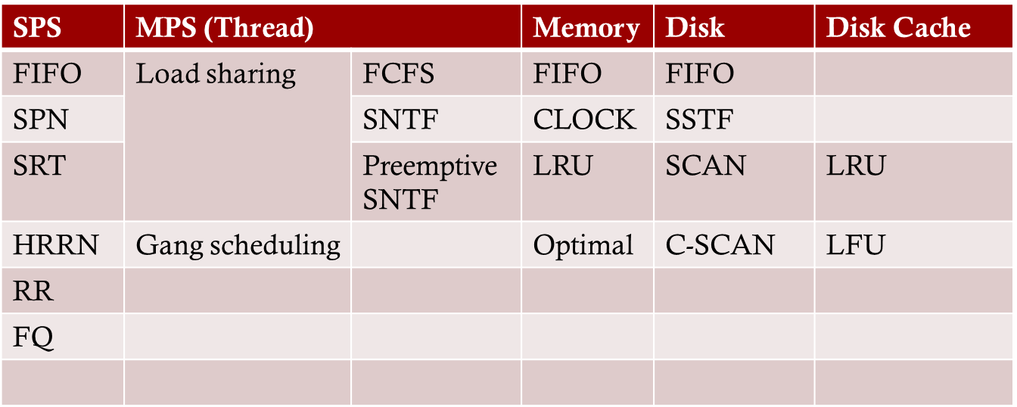
Scheduling

Slide 42
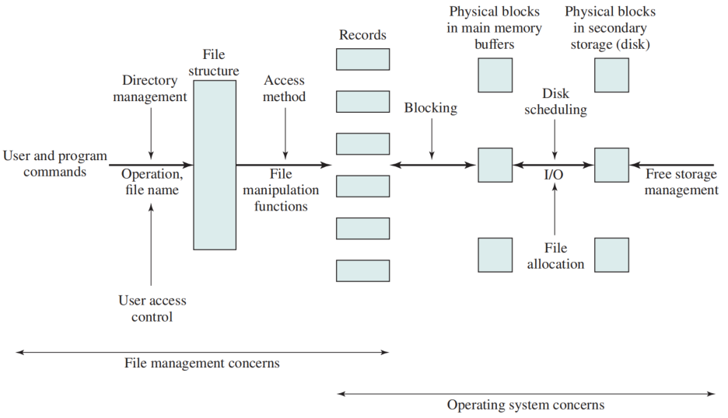
7 Elements of File Management

Slide 43
File Organization and Access
File organization is the logical structuring of the records as determined by the way in which they are accessed
In choosing a file organization, several criteria are important:
  short access time
  ease of update
  economy of storage
  simple maintenance
  reliability
File organization types
  The pile
  The sequential file
  The indexed sequential file
  The indexed file
  The direct, or hashed, file

Slide 44
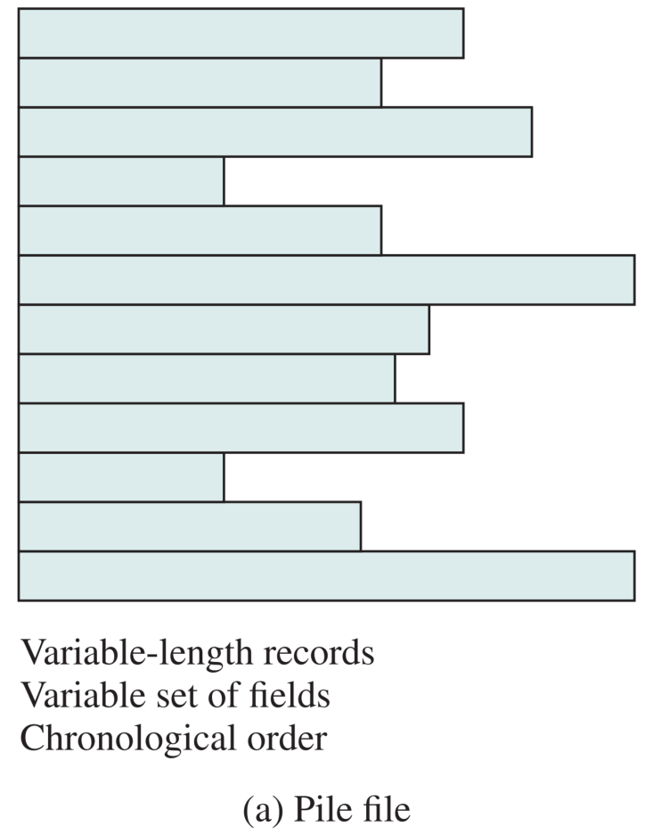
The Pile
Data are collected in the order they arrive
Purpose is simply to accumulate the mass of data and save it
Records may have different fields, or similar fields in different orders
Record access is by exhaustive search

Slide 45
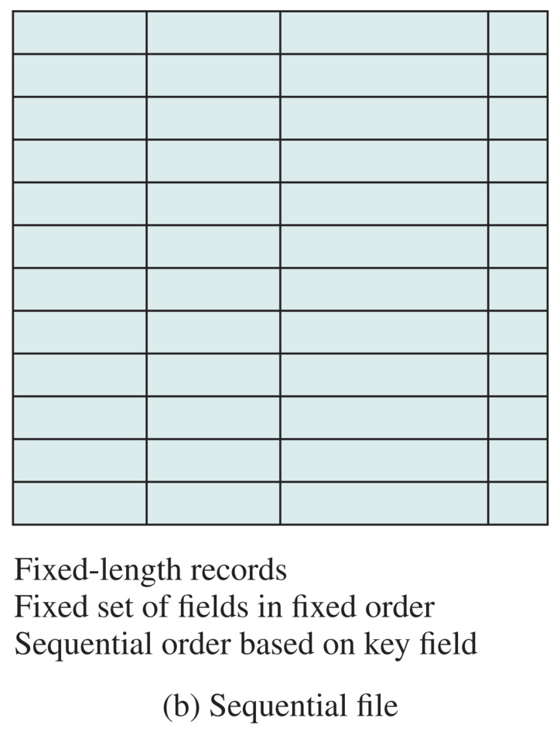
The Sequential File
Most common form of file structure；
Only the values of fields need to be stored;
The field name and length are attributes of the file structure；
Key field (关键域) uniquely identifies the record；
Typically used in batch applications；

Slide 46
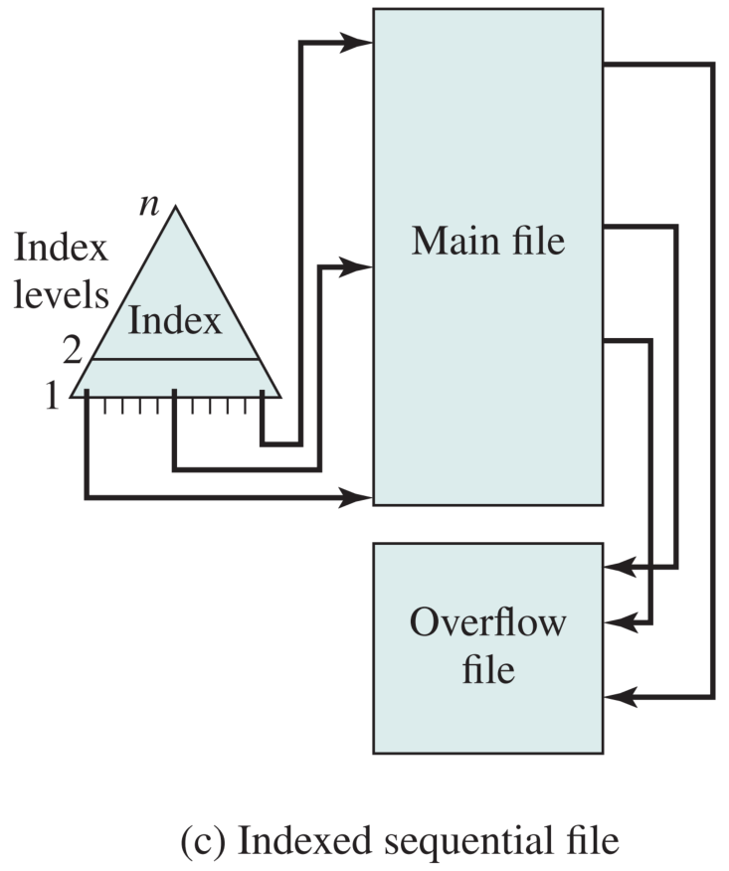
Indexed Sequential File
The indexed sequential file maintains the key characteristic of the sequential file: Records are organized in sequence based on a key field.
Additional features:
  Adds an index to the file to support random access
  Adds an overflow file（溢出文件）to store the new record.
Each record in the main file contains an additional field pointing to the overflow file.

Slide 47
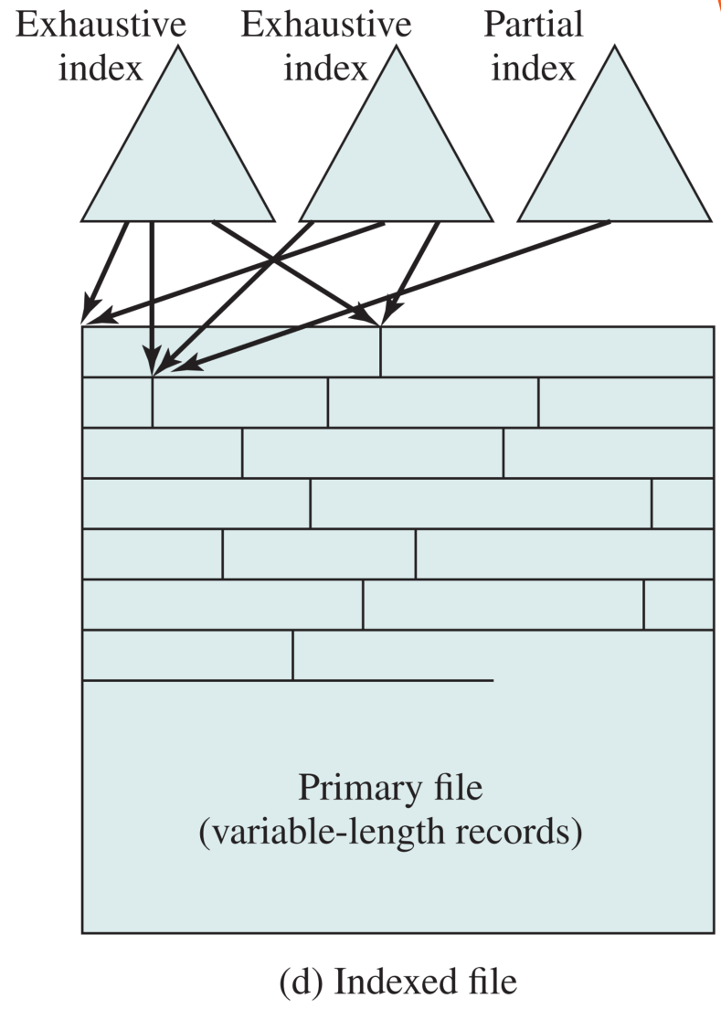
Indexed File
Index key
  Employs multiple indexes, each field may be the subject of a search;
  Records are accessed only through their indexes
Variable-length records can be employed
Index type
  Exhaustive index contains one entry for every record in the main file
  Partial index contains entries to records where the field of interest exists
Index Structure
  sequential file
  Tree
  Hash table
  Bitmap

Slide 48
Direct or Hashed File
Access directly any block with known address
Makes use of hashing on the key value
Often used where:
  very rapid access is required
  fixed-length records are used
  One record is accessed at a time

Slide 49
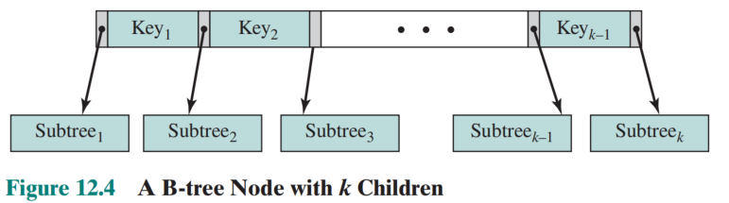
B-Tree Characteristics
A tree structure (no closed loops) with the following characteristics:
  each node contains at least one key which uniquely identifies a file record, and more than one pointer to child nodes or leaves
  each node is limited to the same number of maximum keys
  the keys in a node are stored in non-decreasing order;
  each node has one more pointer than keys

Slide 50
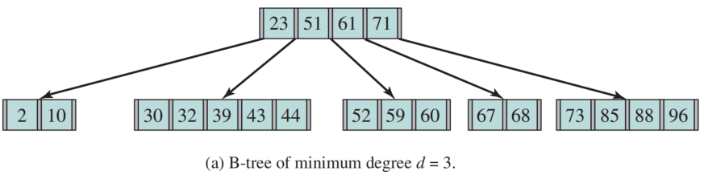
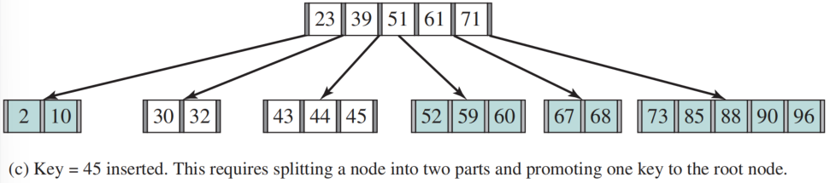
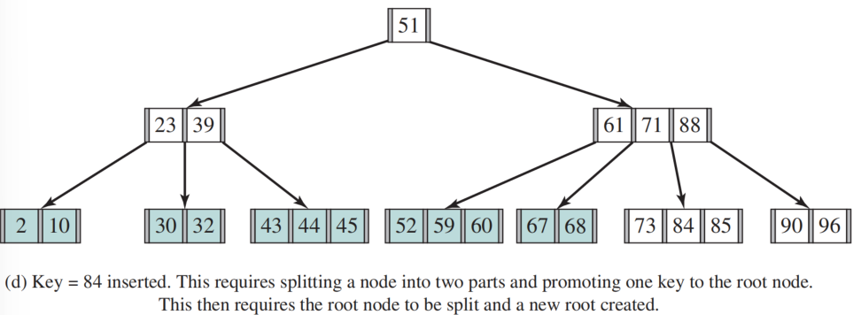
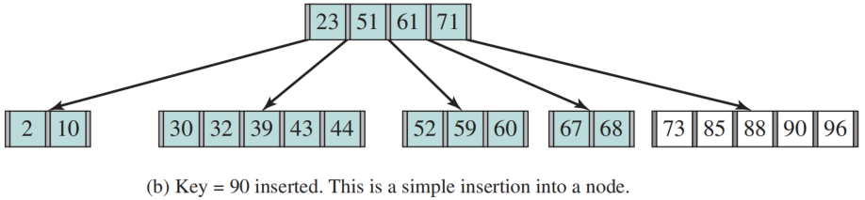
Inserting Nodes Into a B-Tree

Slide 51
Record Blocking（记录组块）
Blocks are the unit of I/O with secondary storage (v.s. process in memory)
for I/O to be performed records must be organized as blocks
Given the size of a block, three methods of blocking can be used:
  Fixed-Length Blocking
    fixed-length records are used, and an integral number of records are stored in a block
    Internal fragmentation – unused space at the end of each block
  Variable-Length Spanned Blocking – variable-length records are used and are packed into blocks with no unused space
  Variable-Length Unspanned Blocking – variable-length records are used, but spanning is not employed

Slide 52
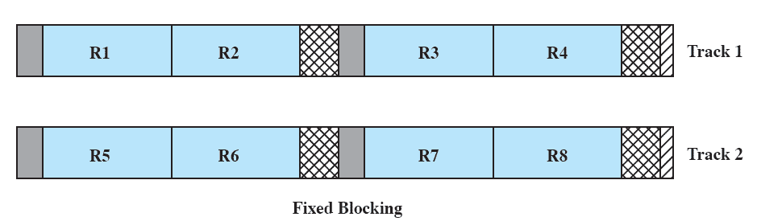
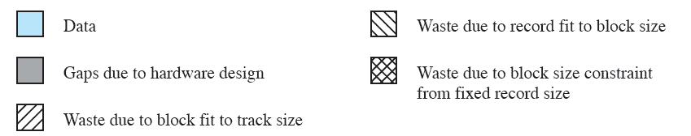
Fixed Blocking

Slide 53
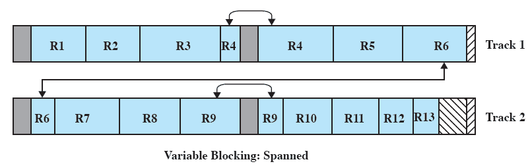
Variable Blocking: Spanned

Slide 54

Variable Blocking: Unspanned

Slide 55

Table 12.3 File Allocation Methods

Slide 56

Method1 : Contiguous File Allocation
A single contiguous set of blocks is allocated to a file at the time of file creation
Preallocation strategy using variable-size portions

Slide 57

After Compaction （紧缩）

Slide 58

Method 2 : Chained Allocation
Allocation is on an individual block basis
Each block contains a pointer to the next block in the chain
The file allocation table needs just a single entry for each file
No external fragmentation to worry about

Slide 59

Chained Allocation After Consolidation（合并）
One consequence is that there is no accommodation of the principle of locality.

Slide 60

Method3 : Indexed Allocation with Block Portions
File allocation table contains a separate one-level index for each file.
The index has one entry for each portion allocated to the file
Indexed allocation supports both sequential and direct access to the file and thus is the most popular form of file allocation
Indexed Allocation with Block Portions

Slide 61

Method4 : Indexed Allocation with Variable Length Portions
Allocation by variable-size portions improves locality.

Slide 62
Free Space Management
DAT (Disk available table)
  Bit table
  Chained Free Portions
  Indexing
  Free Block List

